Slide 1

Case Study: the Newton Raphson Method
Professor Bo Liu
James Watt School of Engineering

Slide 2
Introduction
In this case study we will:
  Use the Newton-Raphson method to find the roots of a polynomial.
You will learn about:
  Using MATLAB loops in an iterative method.
  The Newton-Raphson method.
See live script

Slide 3
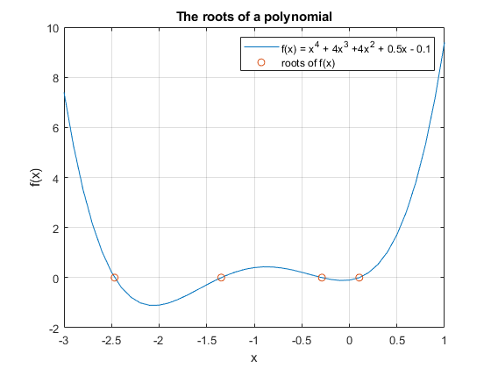
Roots of a Polynomial
The roots of a polynomial (f(x)) are the values of x for which f(x) = 0
See live script

Slide 4
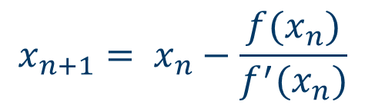
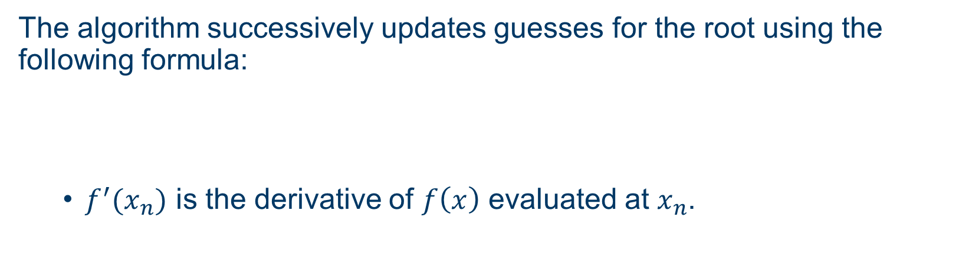
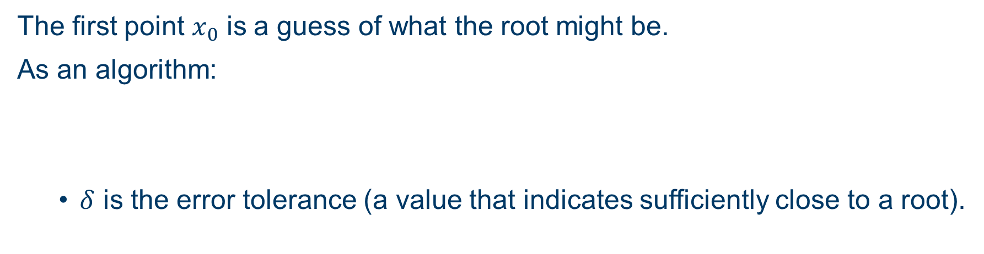
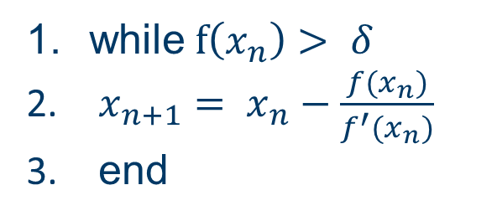
The Newton-Raphson method
The algorithm successively updates guesses for the root using the following formula:
  $f^{′}(x_{n})$ is the derivative of $f\left(x\right)$ evaluated at $x_{n}$.
$$x_{n+1}= x_{n}−\frac{f(x_{n})}{f^{′}(x_{n})}$$
The first point $x_{0}$ is a guess of what the root might be.
As an algorithm:
  $δ$ is the error tolerance (a value that indicates sufficiently close to a root).
while $f\left(x_{n}\right)> δ$
$x_{n+1}= x_{n}−\frac{f(x_{n})}{f^{′}(x_{n})}$
end

Slide 5
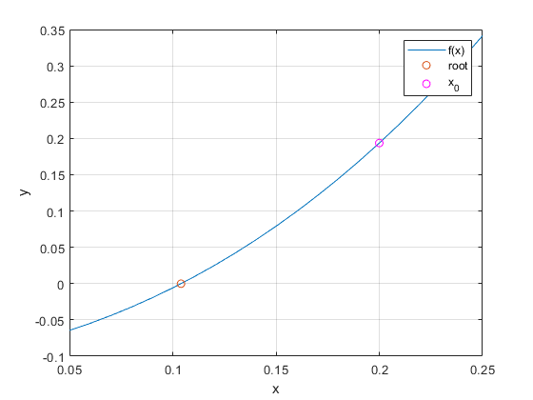
The Newton-Raphson method
The Newton-Raphson method is an algorithm for approximating the root (points where the function value is 0) of a differentiable function.
See live script

Slide 6
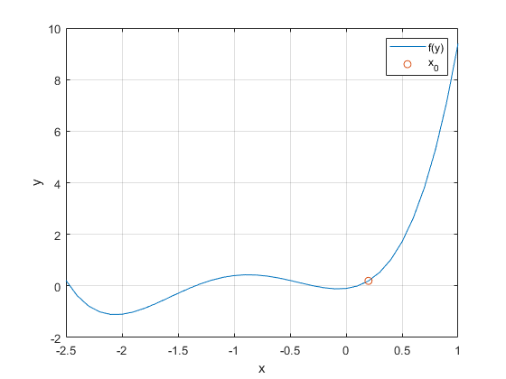
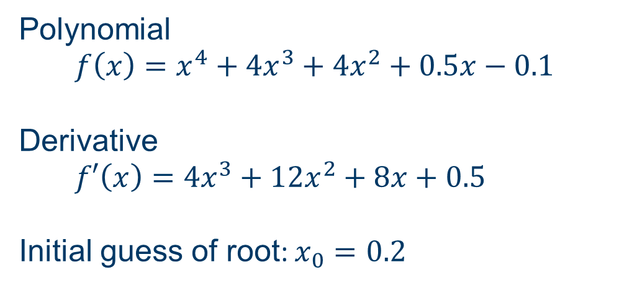
Example part 1
Polynomial
$f\left(x\right)=x^{4}+4x^{3}+{4x}^{2}+0.5x−0.1$
Derivative
$f′\left(x\right)={4x}^{3}+12x^{2}+8x+0.5$
Initial guess of root: $x_{0}=0.2$
Write the polynomial and derivative as a MATLAB function:
  function y = f(x)
    y = x^4 + 4*x^3 + 4*x^2 + 0.5*x - 0.1;
  end
  function dydx = f_prime(x)
    dydx = 4*x^3 + 12*x^2 + 8*x + 0.5;
  end
See live script

Slide 7

Example part 2
Using the function:
  x0 = 0.2; % initial guess
  y0 = f(x0) % f(x) at x0 0.1936
  grad = f_prime(x0) % derivative at x0 is 2.6120
The Newton-Raphson method:
  tol = 0.001; % target tolerance
  x = x0; % initialise x
  while (f(x)>tol)
    y = f(x); % current value of y
    grad = f_prime(x); % current gradient
    x = x – y/grad; % update approximation of root
  End
Final approximation: $x=0.10409, \text{y}\text{ = 1.2414}×{10}^{−4}$
True value of root at: $x≈0.10408$
See live script

Slide 8




Thanks!
#UofGWorldChangers
@UofGlasgow

